Slide 1
Project 8 - PlateTrack: Vehicle Detection, Tracking, and License Plate Recognition in Video Surveillance
Yorgo Younes

Slide 2
System Architecture
1)Vehicule detection Model, with types. (fastercnn)
2)Tracking algorithm (deepSort)
3)License plate detection.
4)Reading License plate number.
For each frame of the video, they will pass these 4 phases.
And informations will be stored in a dictionnary as a report.

Slide 3
Vehicle detection.
Goals:
Return each detection, with scores, label and coordination.
Pass results to tracking algorithm.
Weakness:
Vehicle like mini-vans confuse the model.
Shadows of car in some frames can count as vehicle.

Slide 4
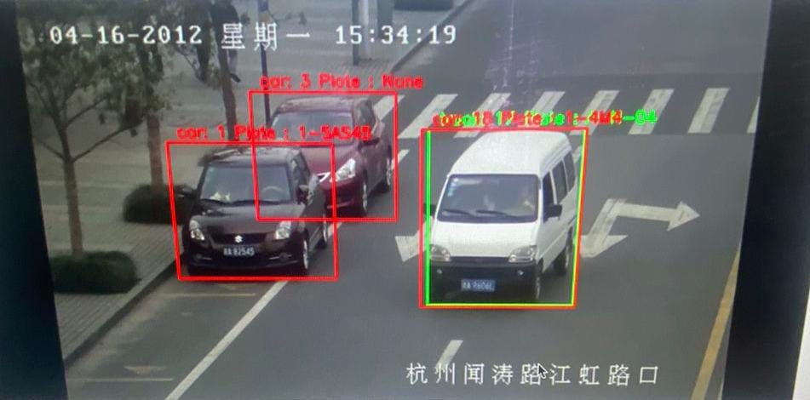

Slide 5
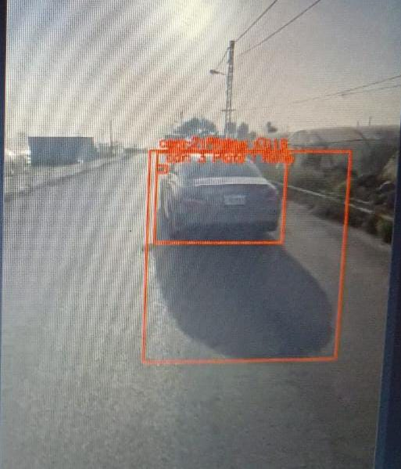

Slide 6
solutions
NMS threshold, to minimize overlapping of same vehicle.

Slide 7
Tracking Algorithm
Goals:
Keep track of every vehicle between frame , assigning each an id.
Get license plate of each track if possible, crop the car frame.
Store information's of each track in a dictionary.
Problem:
tracking was altering coordinations for "prediction" reason,messing up completly my detections result.(
unable to get informations related to track (label and score).

Slide 8
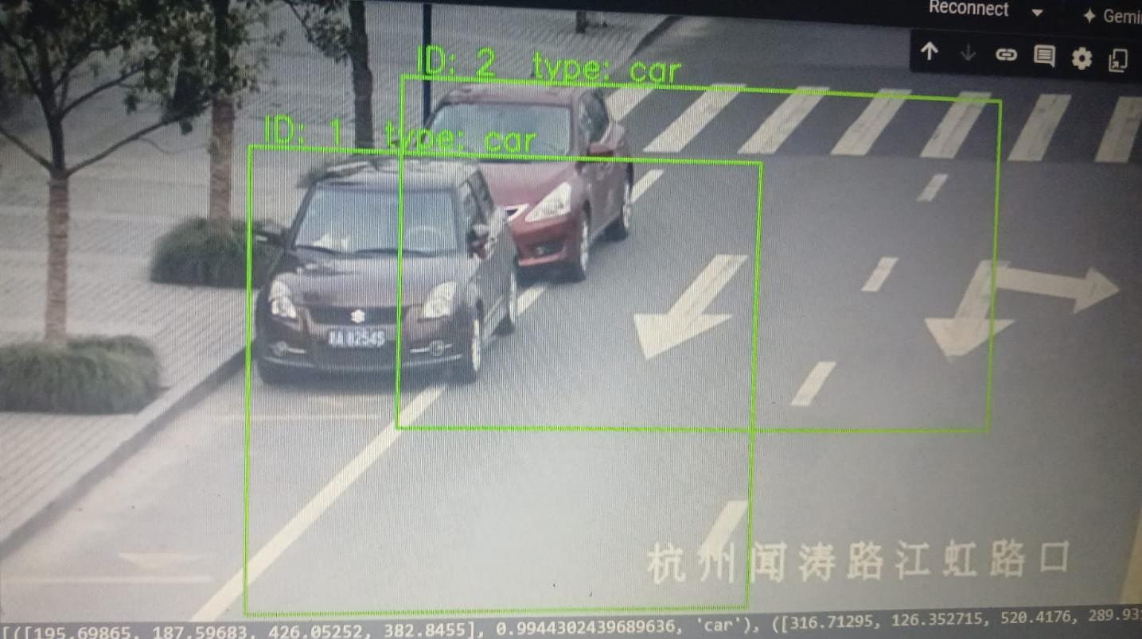

Slide 9
Solution
Non-Maximum Suppression.
added parameters to tracking “org=true” to save original coordination.
get_det_supplementary() to get all additional info.

Slide 10
Detect license plate
Goal: detect license plate position in a car frame.
For our model dataset we needed a dataset that had good data,different angle and shape, plus for time management reason not very big.
Difficulties:
.xml format was my first time working on, as well as yolo training, however online documentation and demos were helpful.

Slide 11
Outcome
Detection plate located : cropped the frame and pass it to our next model, reading the plate.
Not located, return none, with 0.0 score.

Slide 13
Reading Plate
Goals:
Read license plate even in hard condition, return result with score.
Due to bad result on pretrained model, we build our own, adding to the first dataset, a second dataset. A-Z 0-9. cover most characters.
Results to note after training:
CER (Character Error Rate) - 0.127660: which 12% of characters are incorrect, which is good, but can be better.
Results are a lot better the closer the car is to the camera.

Slide 14
Overall challenges
between frame, license plate(or type) result can be diffferent,and the last result will always overide the one before in the dictionnary.So how to keep the best one?
handling the images/frame passed between model, reformating or resizing each frame to accomodate models.
this was solved by print debugging, and reading source code.

Slide 15
Info Dictionnary
4 values:
scores of label[0], and labels[1]. vehicle type and the probabilities of the result
scores of plates[2], and plate[3]. plate number and it s probability,
So each loop, we will compare scores gotten, and store the better value.
this proved to be, effcient and solved this concern.
however there was still some weakness in reading.

Slide 16
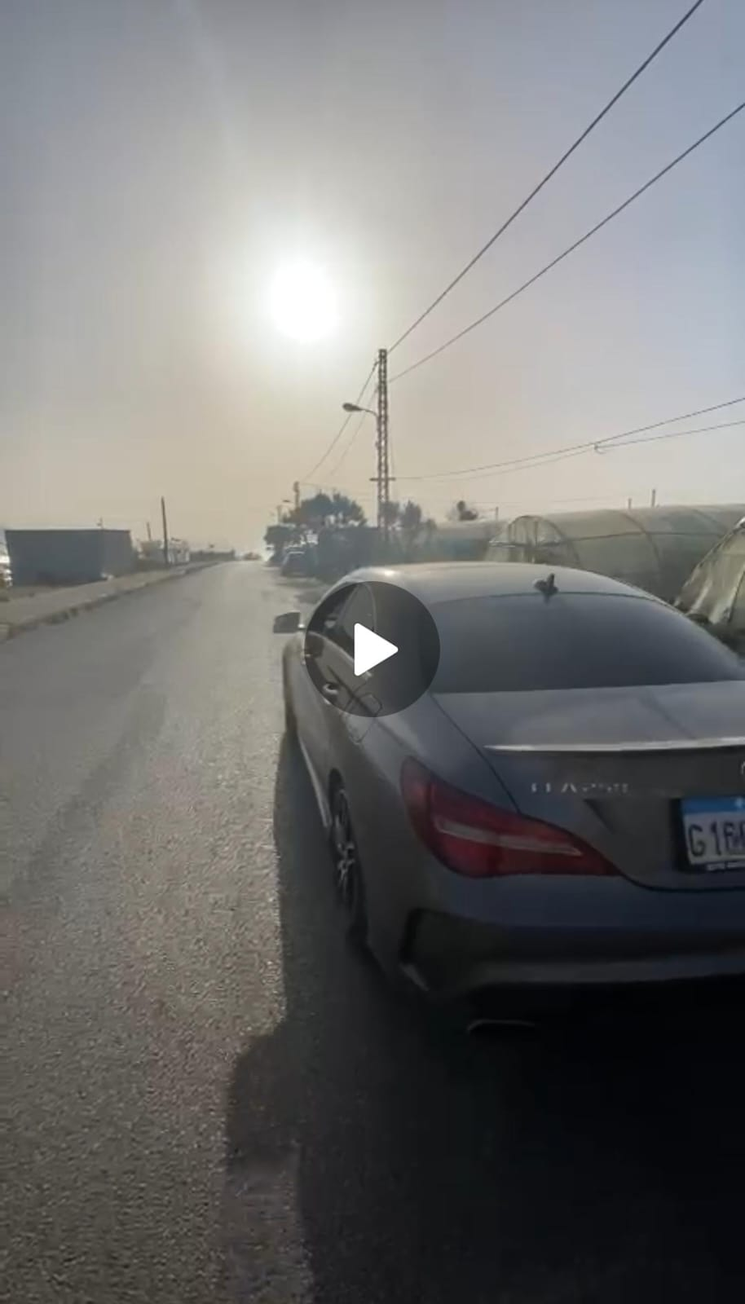

Slide 17
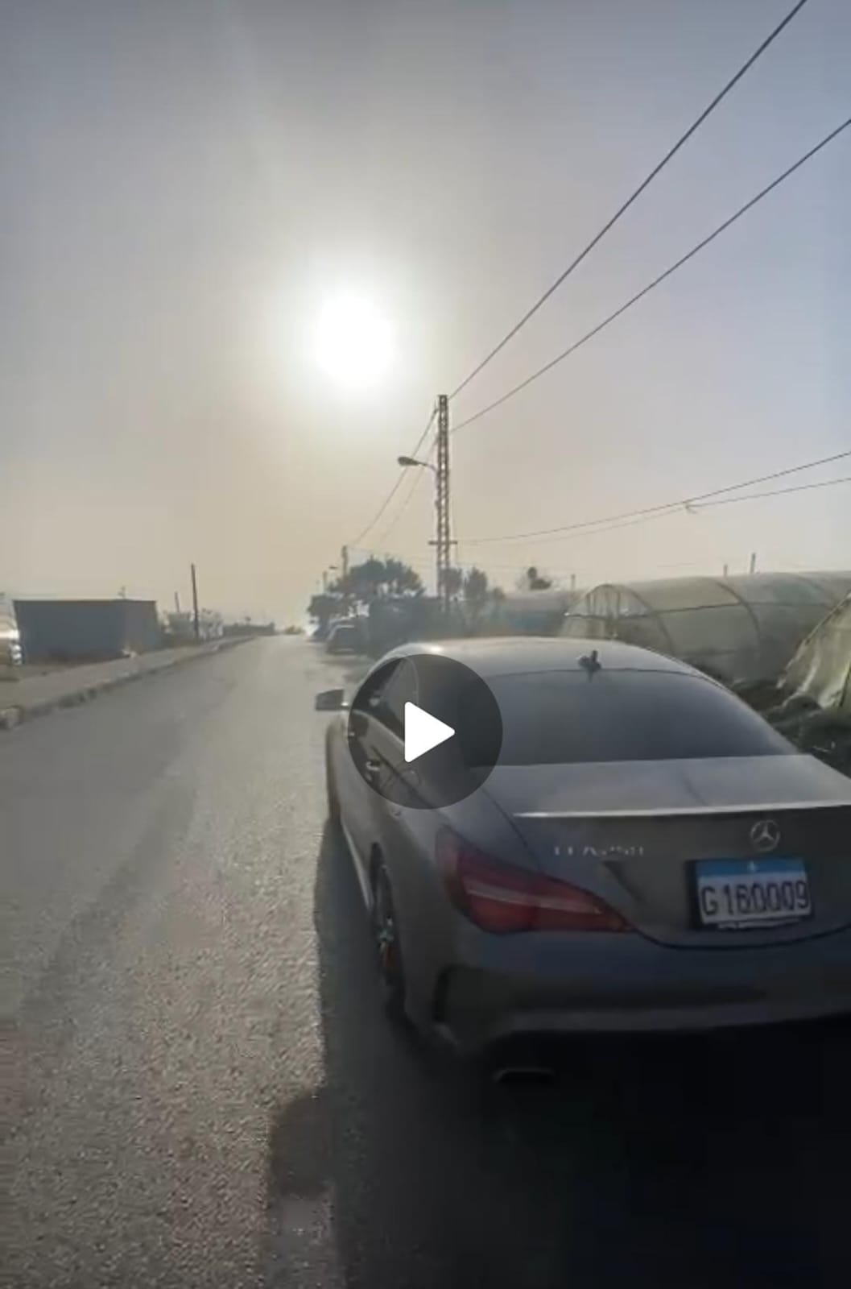

Slide 18
usage
Can work for overall plates like lebanese plate.
it did good in night time, but streetlight presence is preferable.
camera height does impact the reading result, the higher it is, the harder it is to read.
A side angle is harder to get the number of the plate.

Slide 19
improvement
more stability on the detections side.(improving detections will impact tracking)
I would improve my detectionn plate model to know when the whole plate is in the frame,choose the best result better, and train on more international plate.
improvise results on these situation: further distance, very fast cars, broken plate.
Improvise time to process a video.
add more informations, speed of the car, time of entering/leaving.
hardware improvement.

